Slide 1


UNIVERSITY INSTITUTE OF ENGINEERING
Academic Unit V
Bachelor of Engineering
(Computer Science & Engineering)
Biology For Engineers
23SZT148
Bio Signals/ Biomedical Signals
Basic Medical Instrumentation system
DISCOVER . LEARN . EMPOWER

Slide 2

Course Objective
This subject is designed to impart fundamental knowledge on basic and emerging fields of biology like bioinformatics.
It is designed to impart knowledge that how to apply basics of biology in engineering.
https://images.app.goo.gl/pfWfHfCFP56qo7wC7

Slide 3
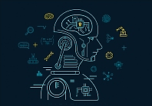
Course Outcome
CO Number | Title | Level
CO1 | Identify the biological concepts from an engineering perspective. | knowledge
CO2 | Development of artificial systems mimicking human action. | Understand
CO3 | Explain the basic of genetics that helps to identify and formulate problems | Analyze
CO4 | Apply knowledge of measurement system, biomedical recording system and biosensors to excel in areas such as entrepreneurship, medicine, government, and education. | Apply
CO5 | Integrate biological principles for developing next generation technologies, | Create
Will be covered in this lecture
https://images.app.goo.gl/5obqqxo93P2UBmdU6

Slide 4


SYLLABUS
Unit-2 | Biosensors and measurement system | Contact Hours: 15
Chapter 1 Medical Instrumentation Chapter 2 Measurement System Chapter 3 Biological Sensor | Medical Instrumentation: Sources of biomedical Signals, Basic medical Instrumentation system, Performance requirements of medical Instrumentation System, Microprocessors in Medical instruments, PC base medical Instruments, General constraints in the design of medical Instrumentation system, Regulation of Medical Devices. Measurement System: Specification of instruments, Statics & Dynamic characteristics of medical instruments, Classification of errors. Statistical analysis, Reliability, Accuracy, Fidelity, Speed of responses, Linearization of technique, and Data Acquisition System. Biological sensors: Sensors/ receptors in the human body, basic organization of the nervous system- neural mechanism, Chemoreceptor: hot and cold receptors, sensors for smell, sound, vision, Ion exchange membrane electrodes, enzyme, glucose sensors, immunosensors, & biosensors & applications of biosensors.

Slide 5
Medical Instrumentation
Bio Signals/ Biomedical Signals
Basic Medical Instrumentation system

Slide 6
Bio Signals/ Biomedical Signals

Slide 7
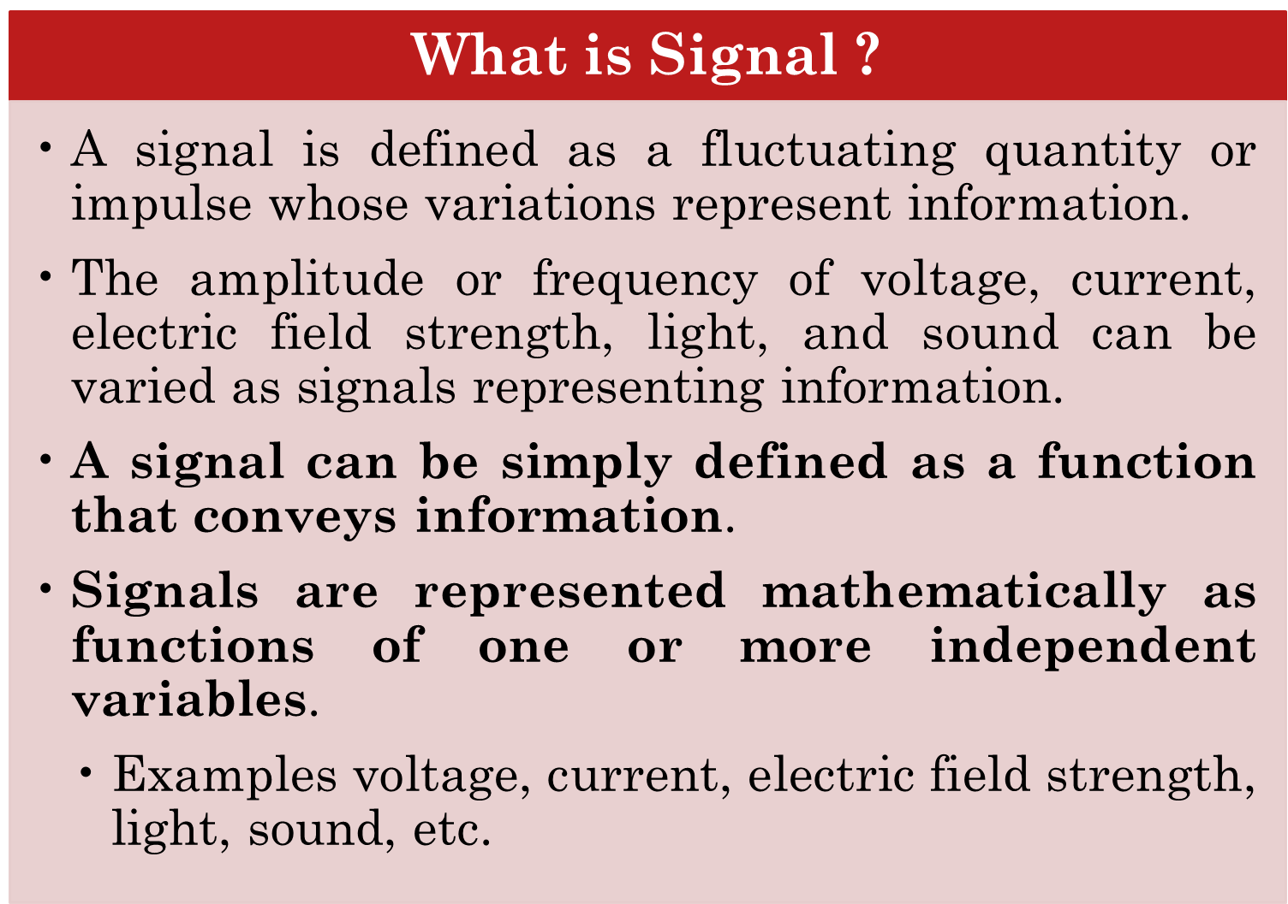

Slide 8
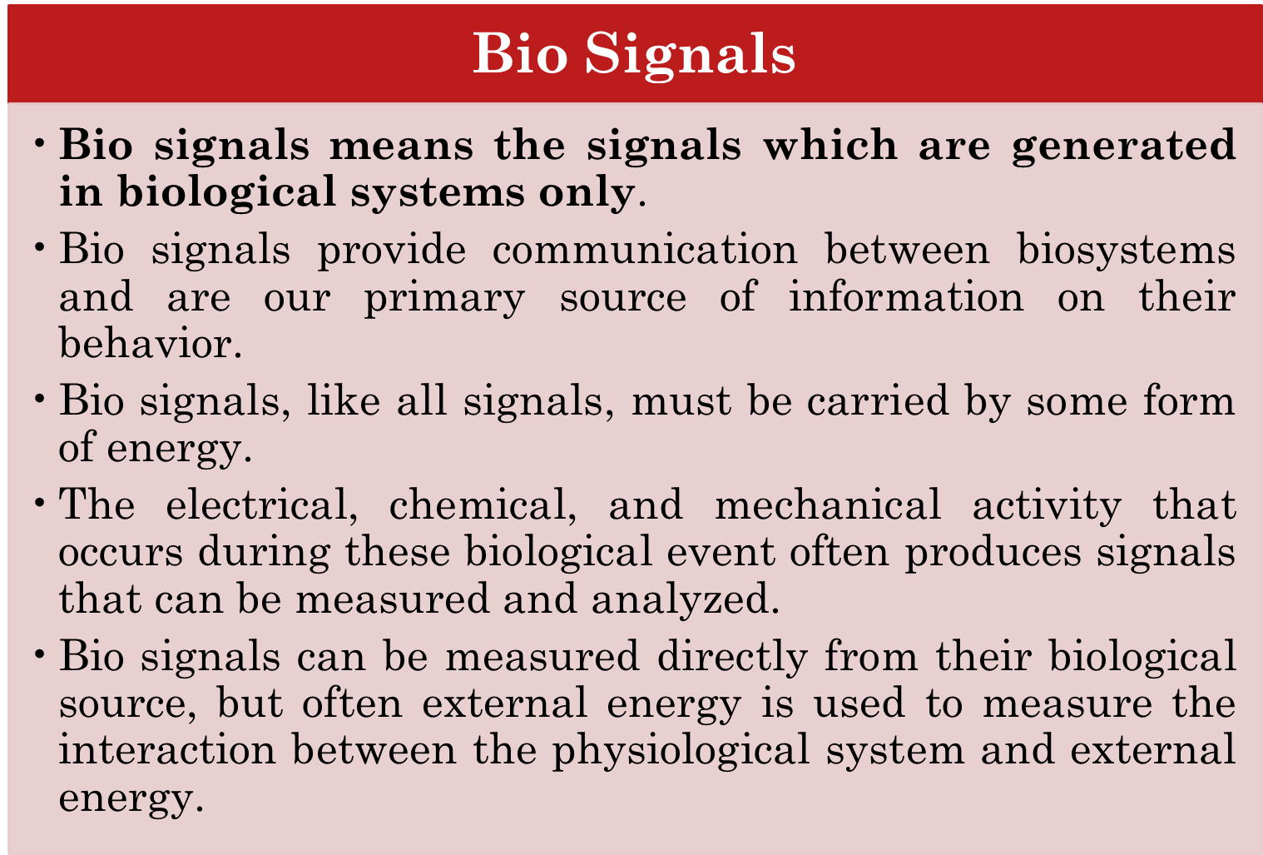

Slide 9
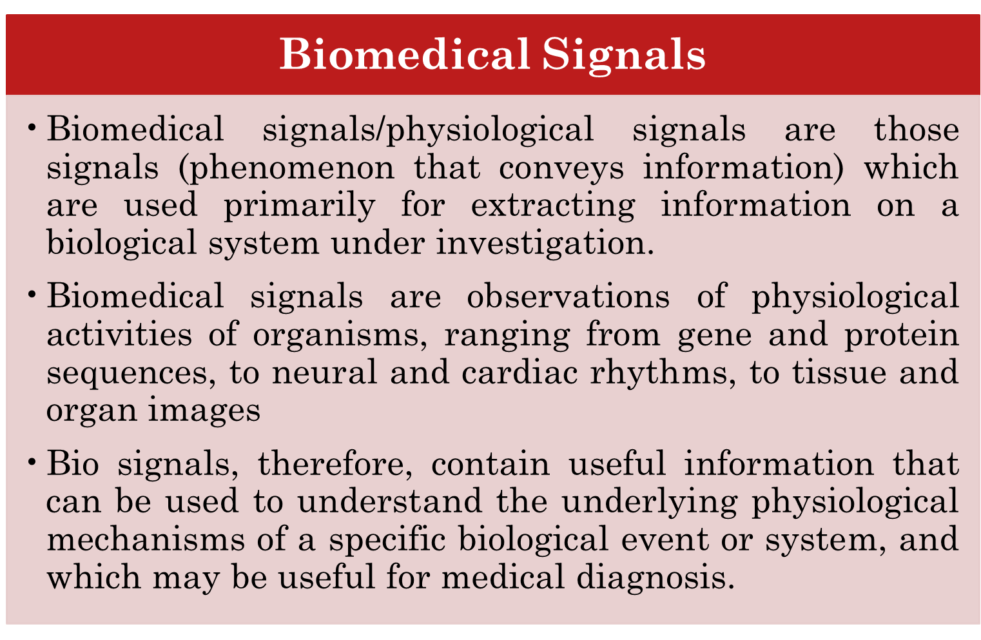

Slide 10
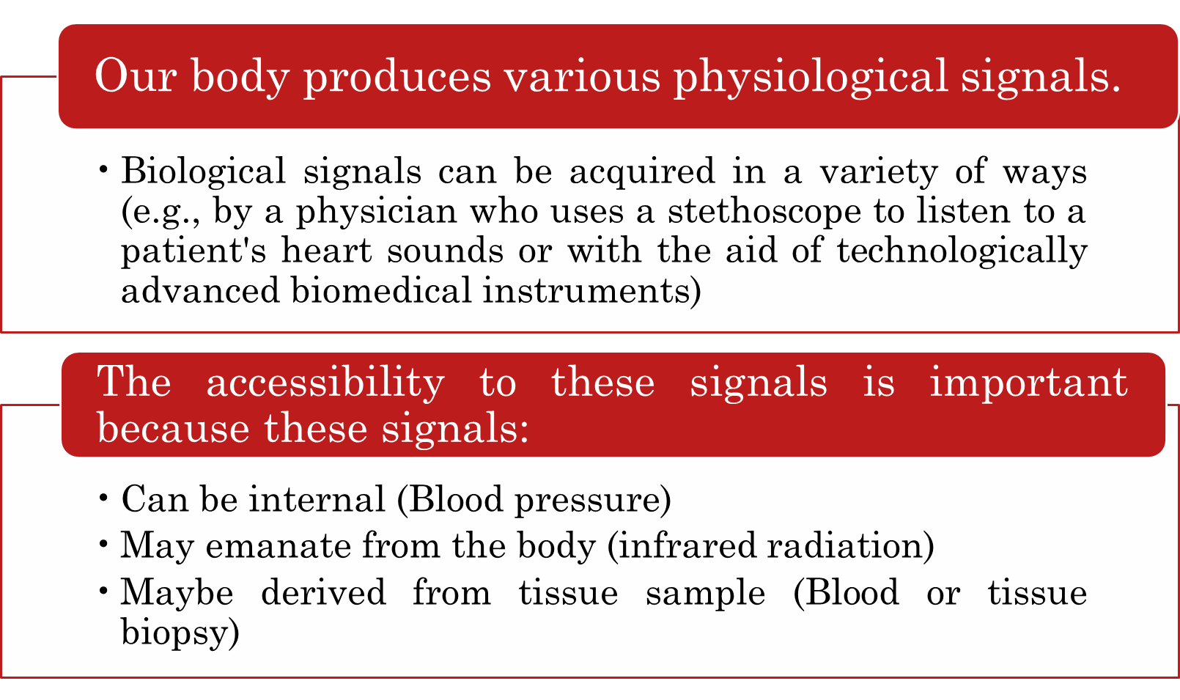

Slide 11
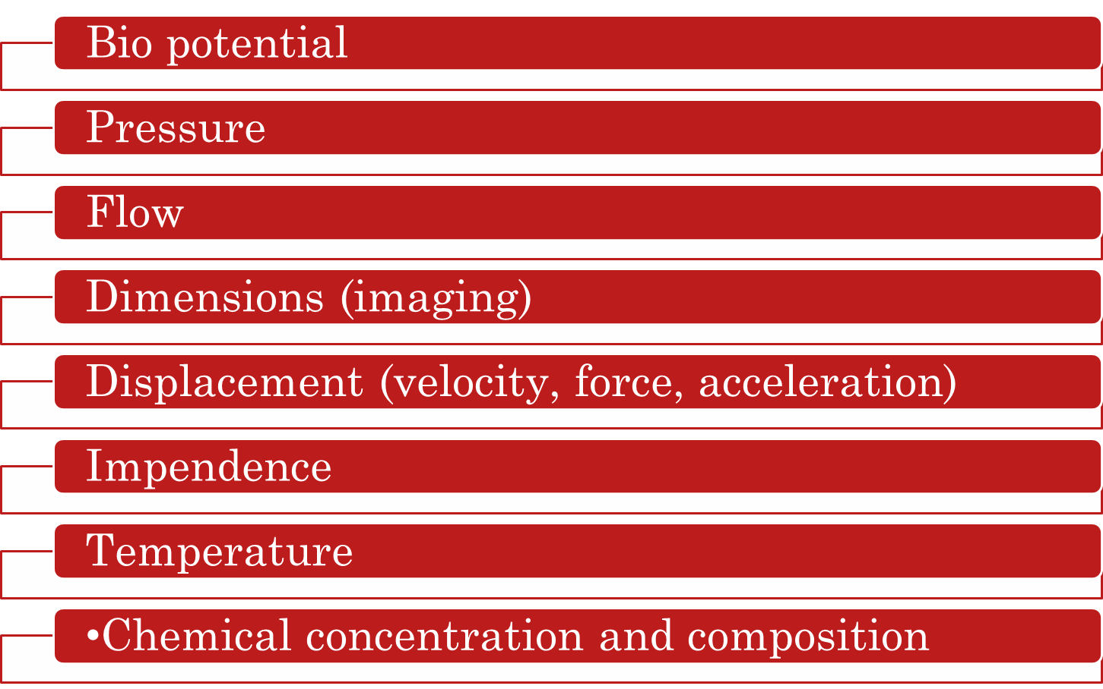
All physiological signals can grouped as:

Slide 12
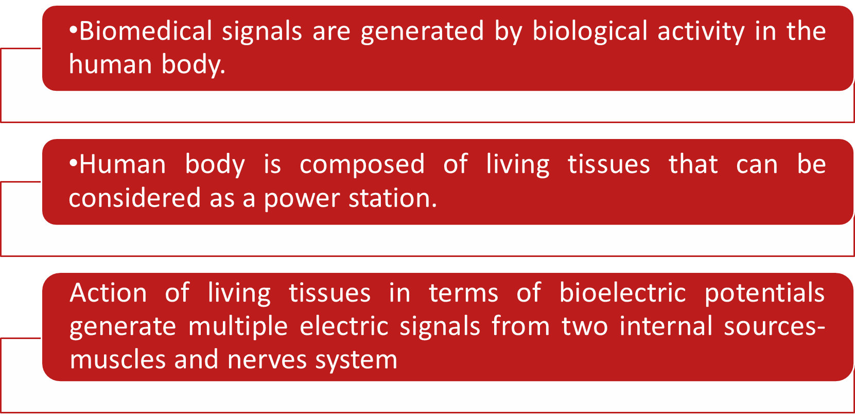
How biomedical signals are generated ?

Slide 13
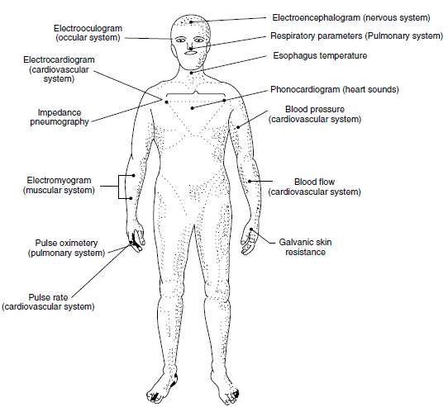
Biomedical signals/Physiological signals are classified according to where they originate from within the body

Slide 14
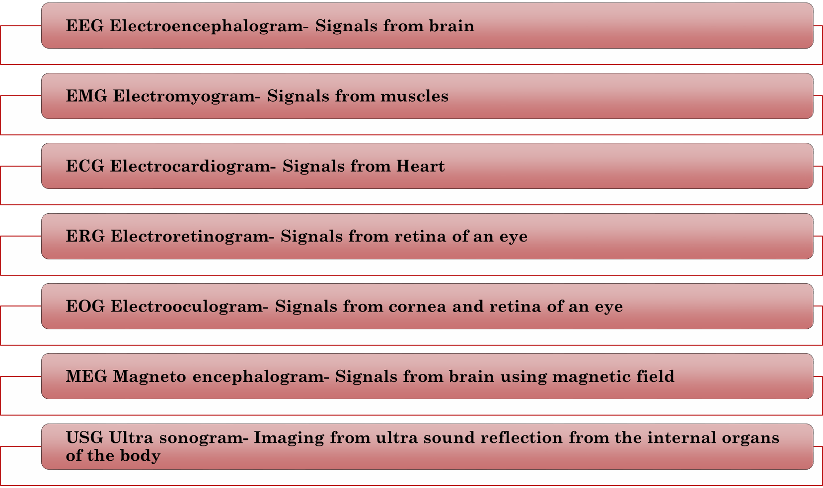
Sources of Biomedical Signals

Slide 15
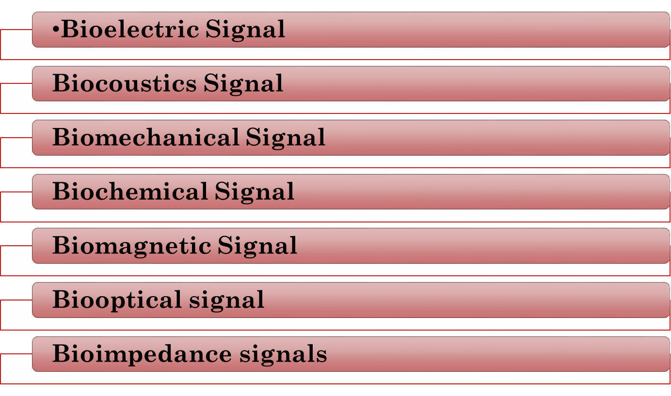
Classification of Biomedical Signals

Slide 16
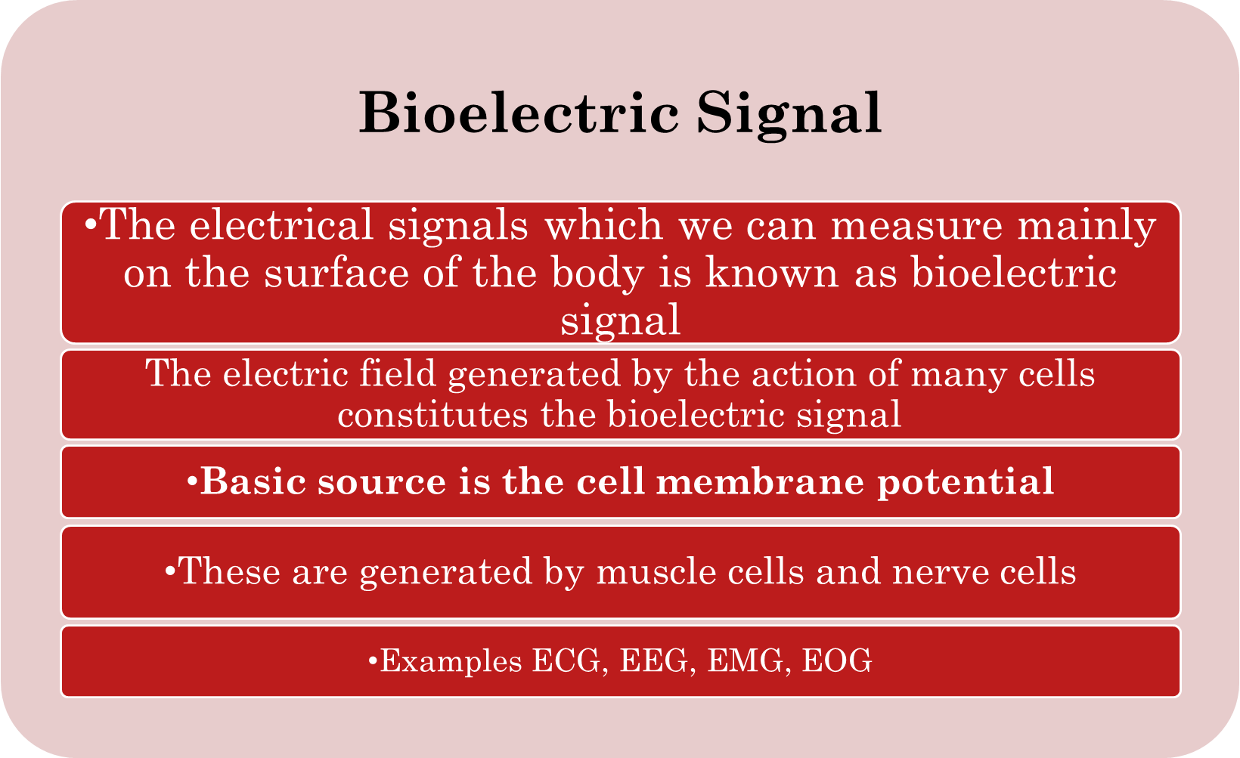

Slide 17
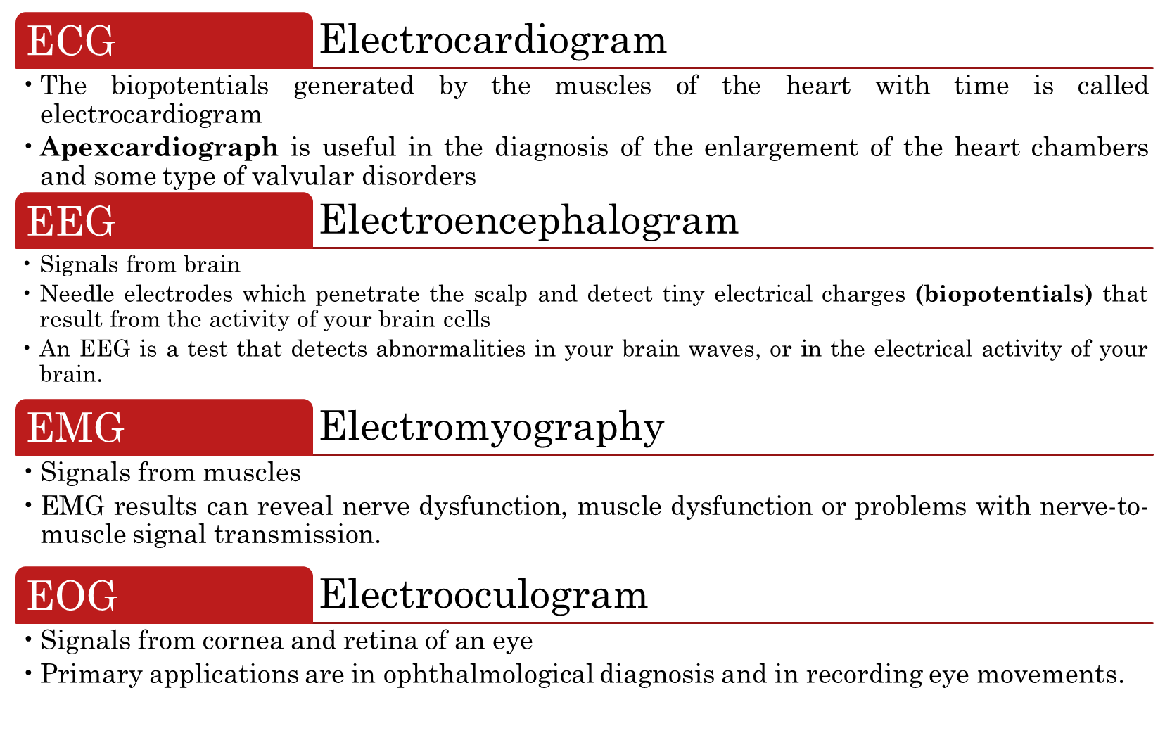

Slide 18
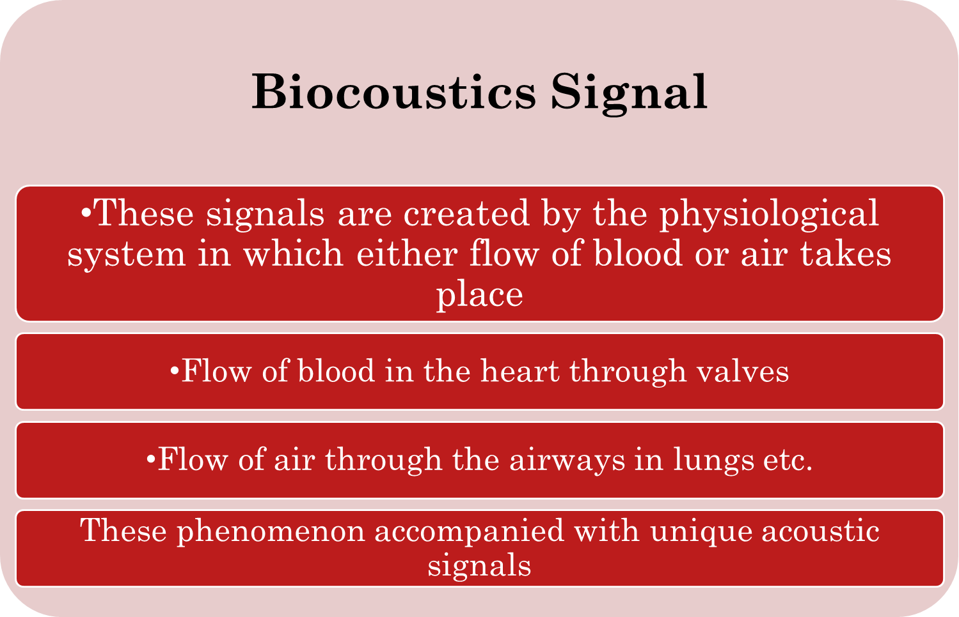

Slide 19
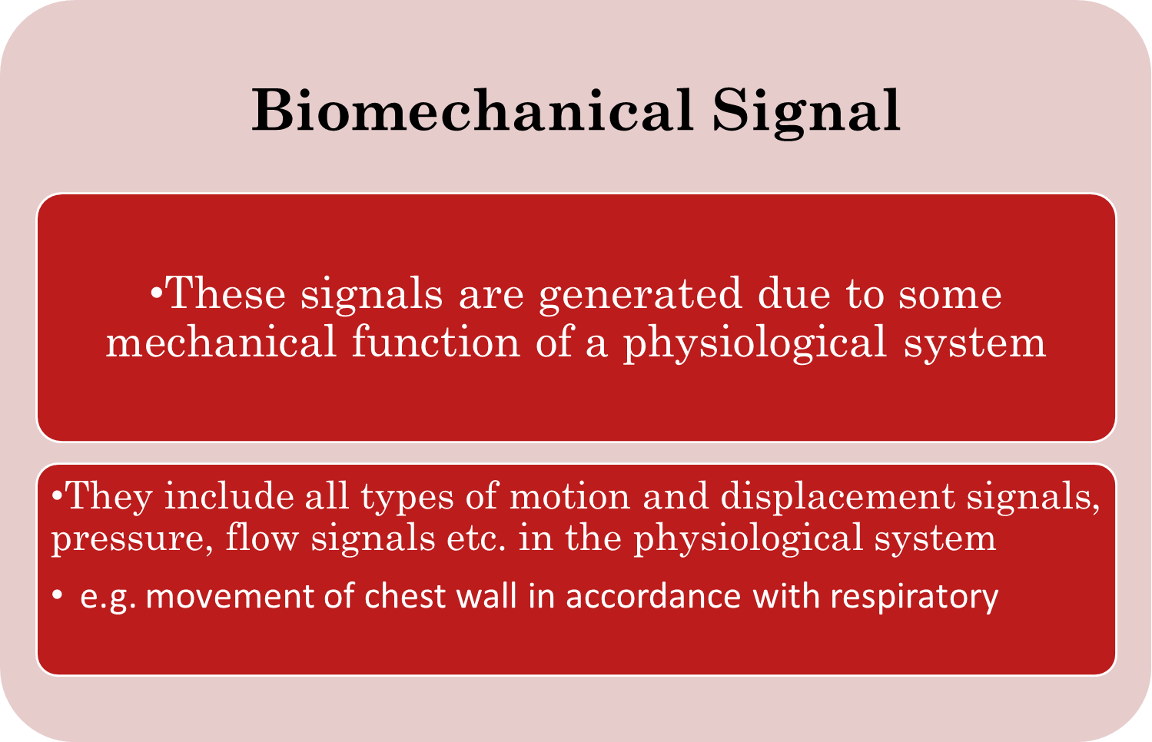

Slide 20
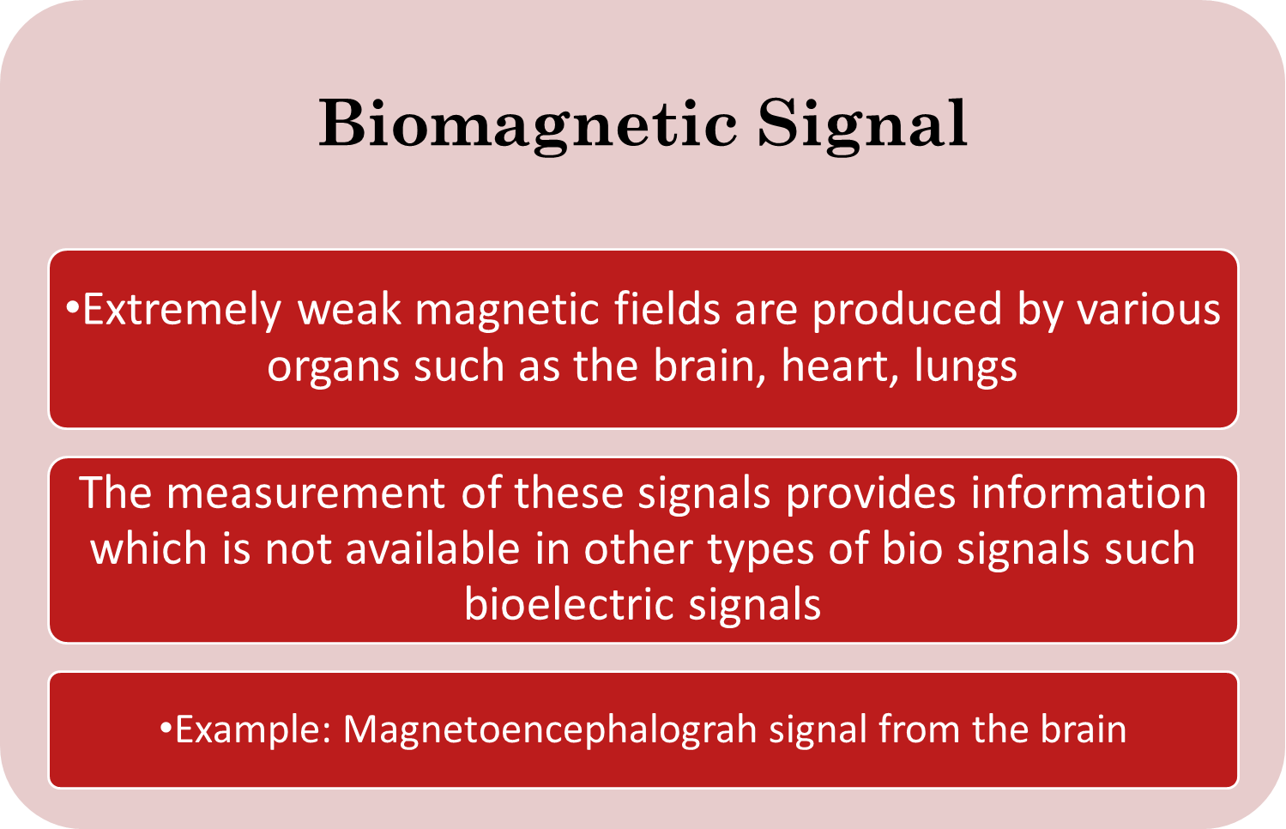

Slide 21
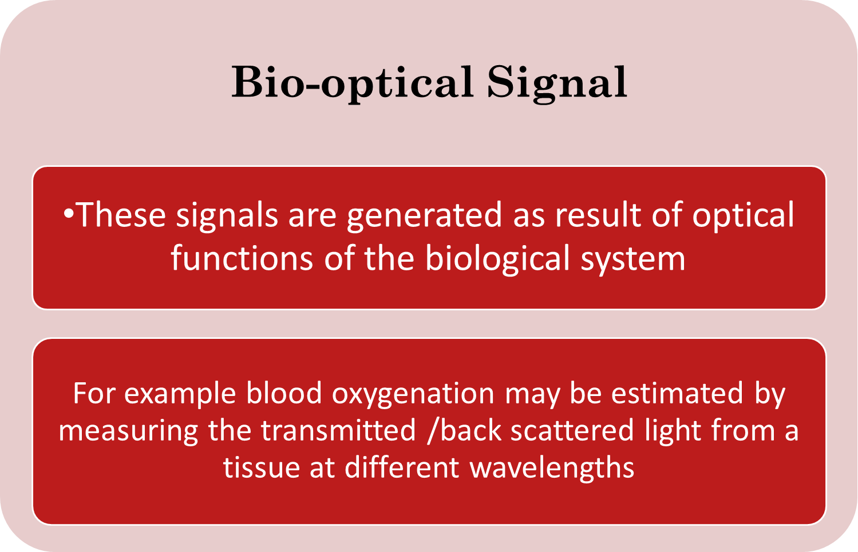

Slide 22
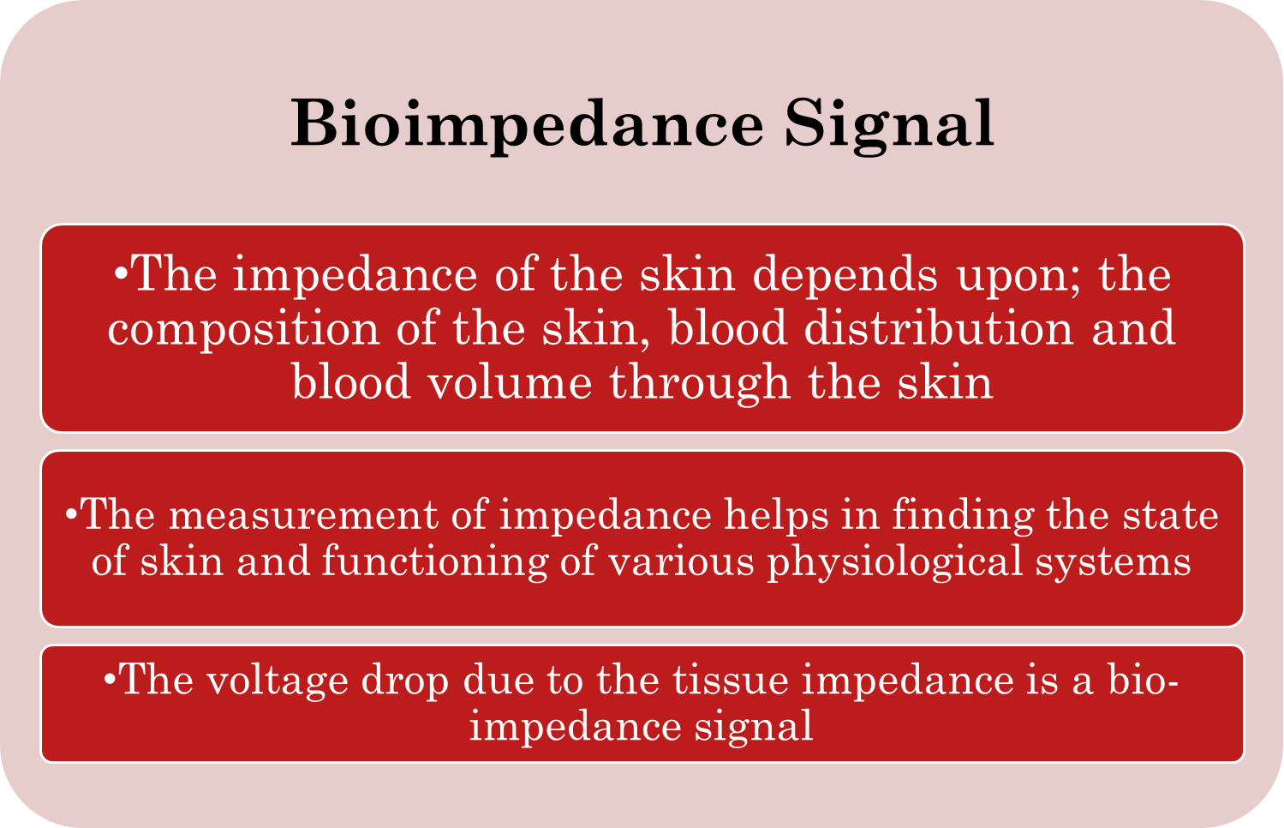

Slide 23
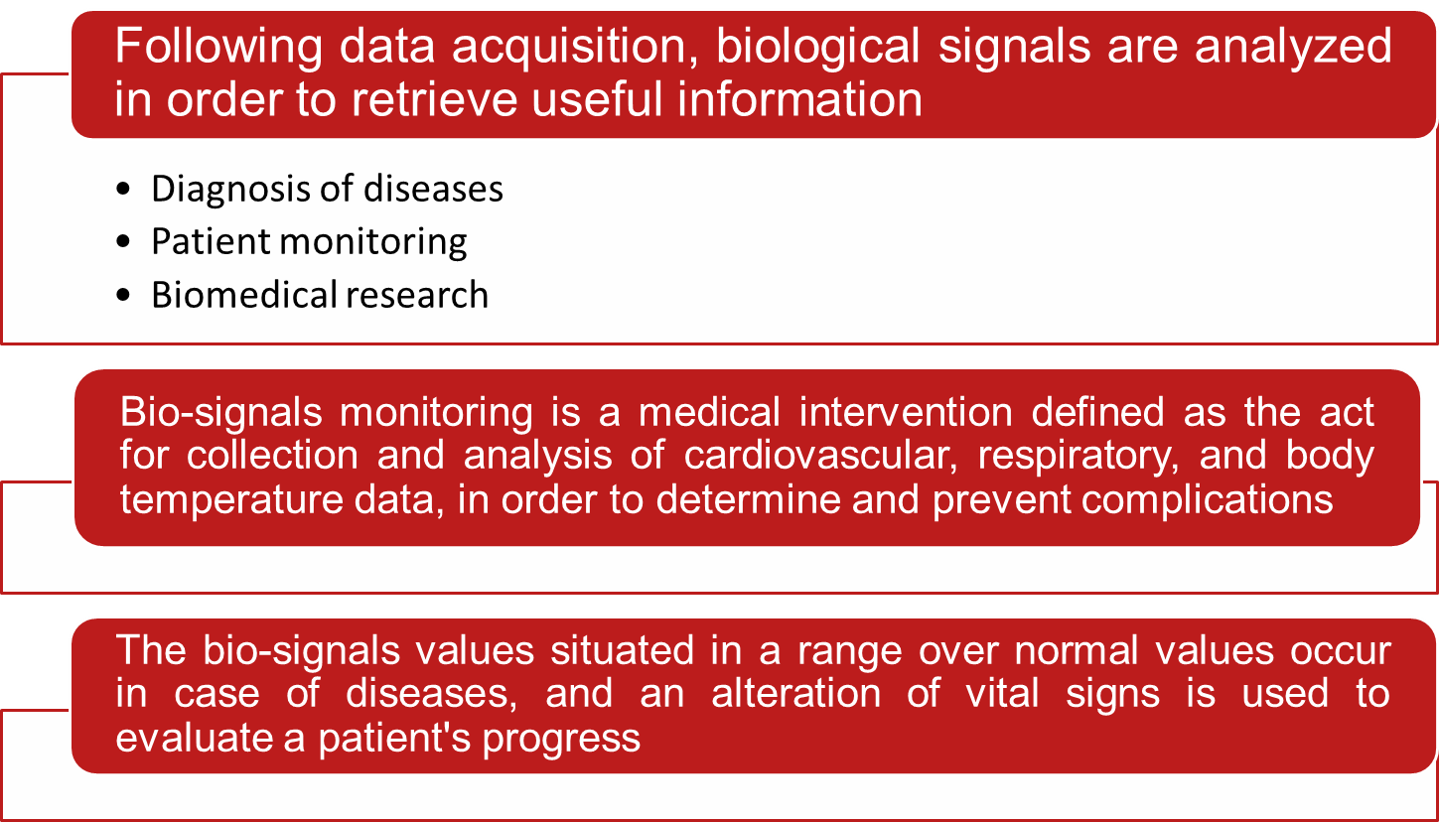
Importance/Applications of Bio signals

Slide 24
Basic Medical Instrumentation System

Slide 25
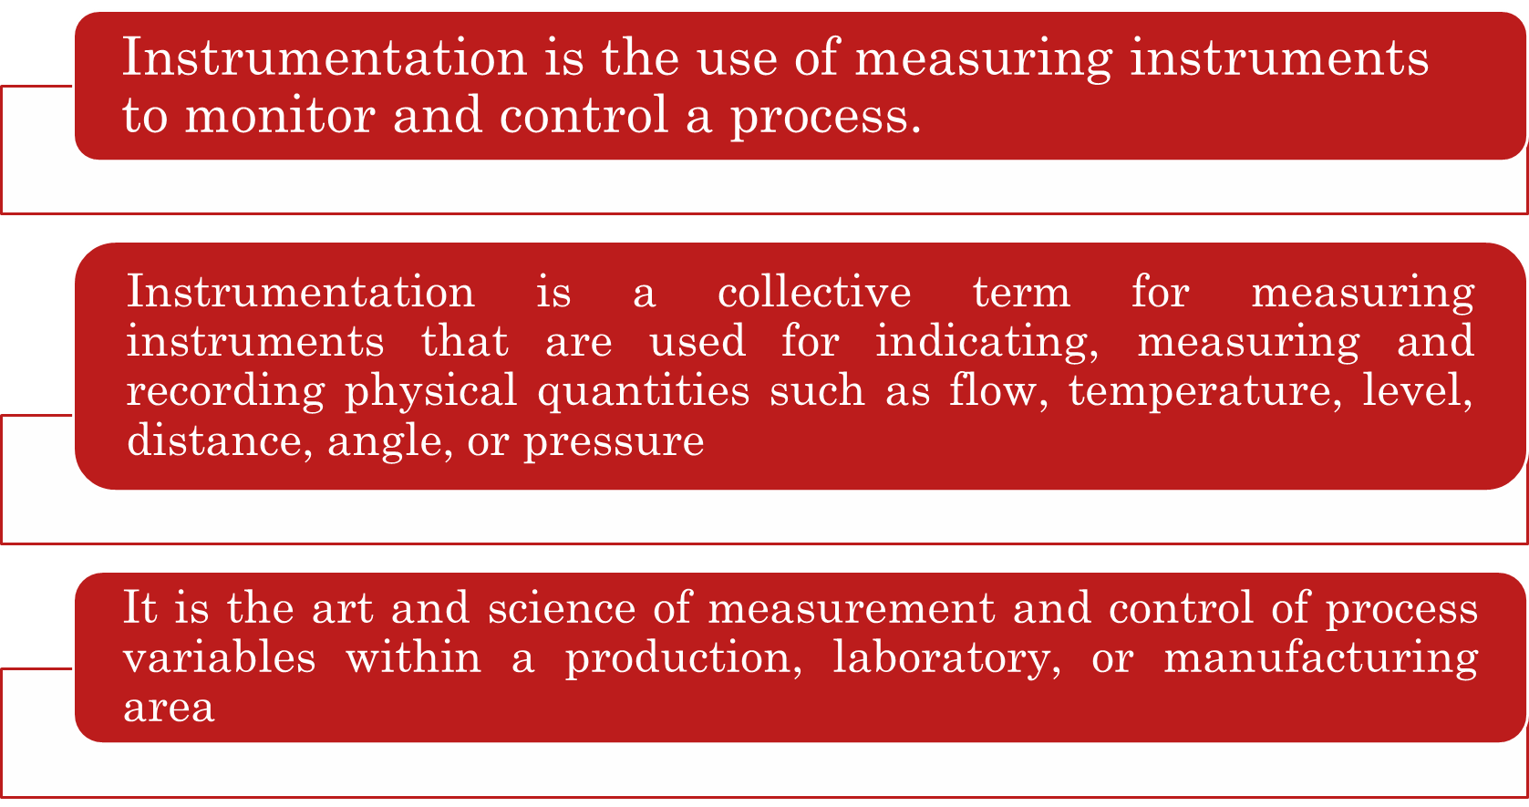
INSTRUMENTATION

Slide 26
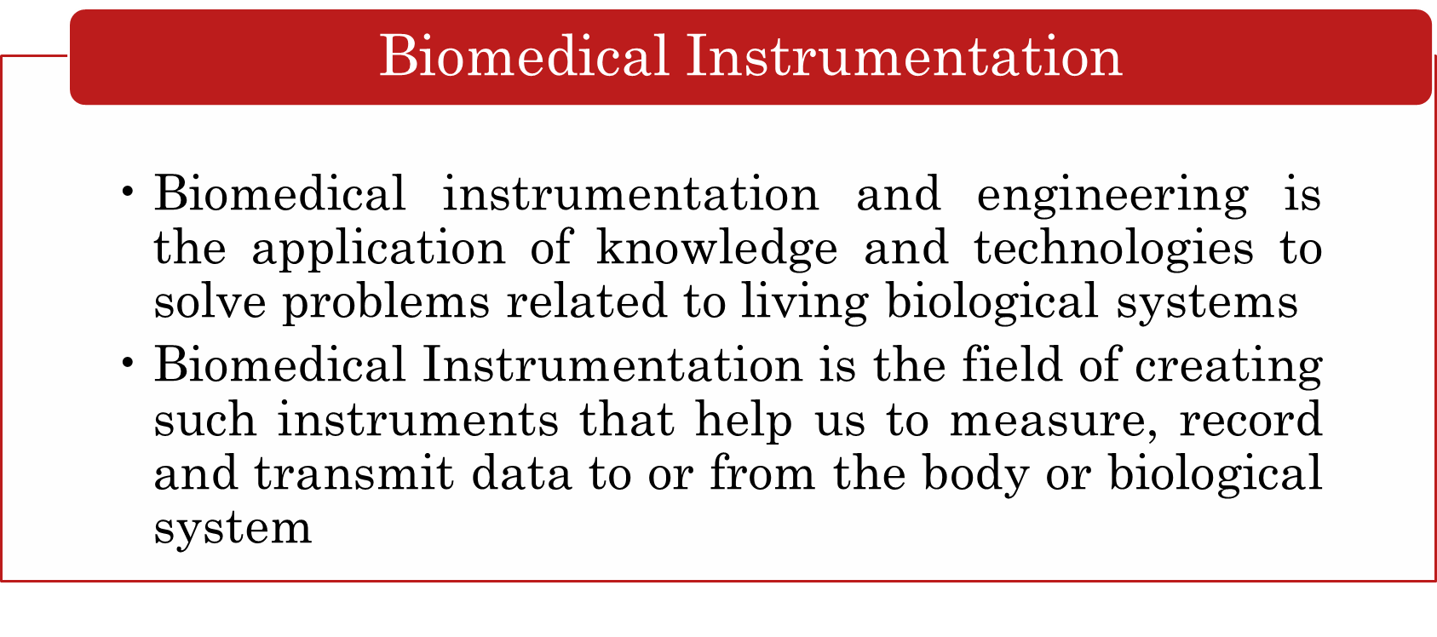
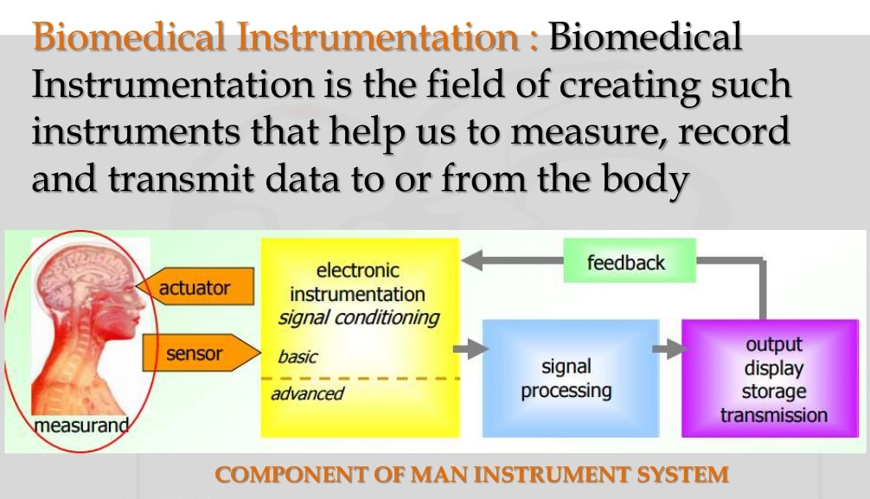

Slide 27
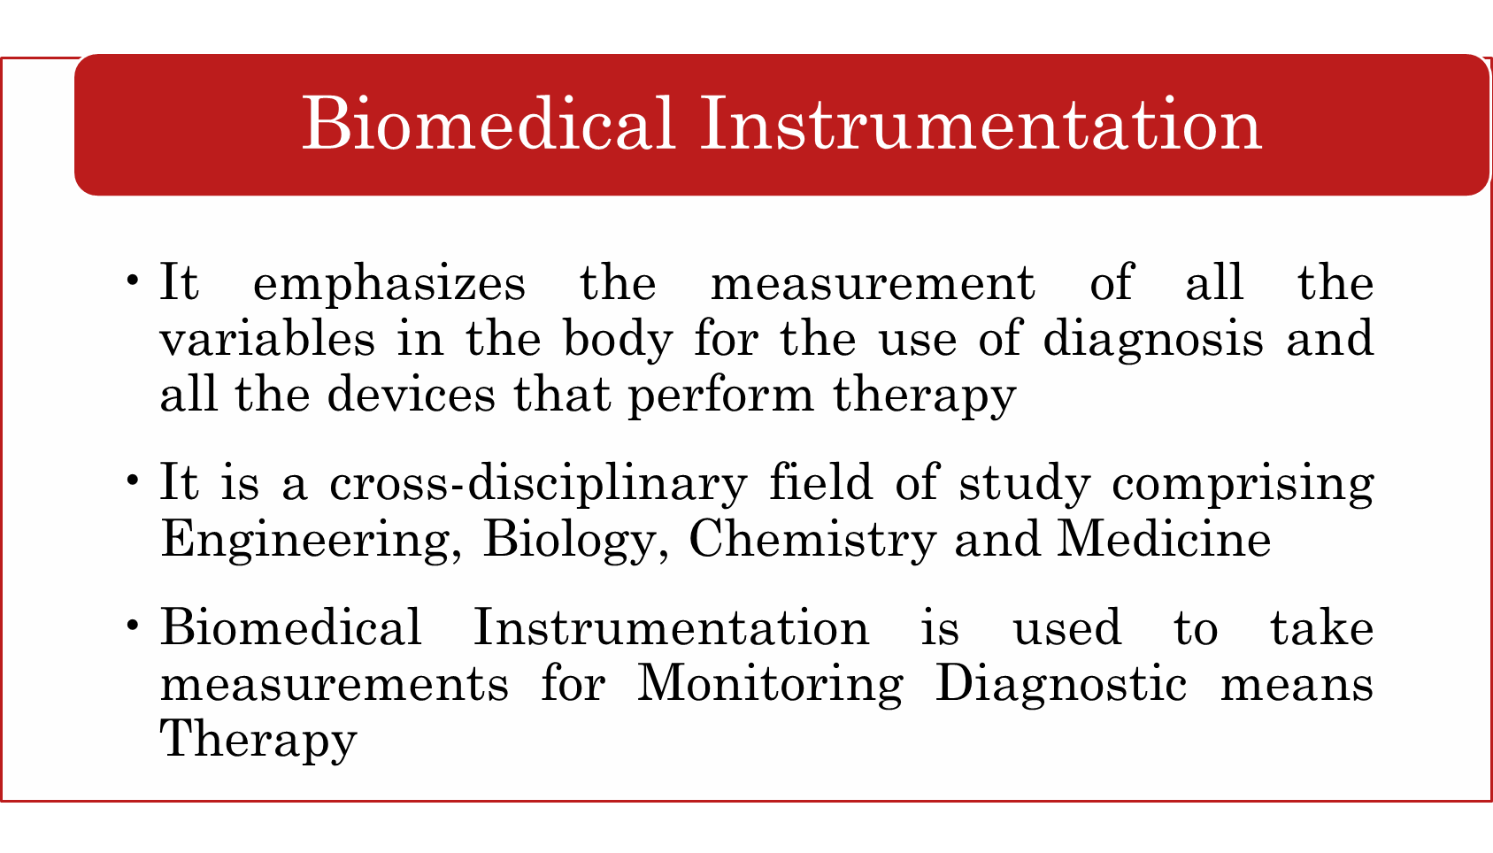

Slide 28
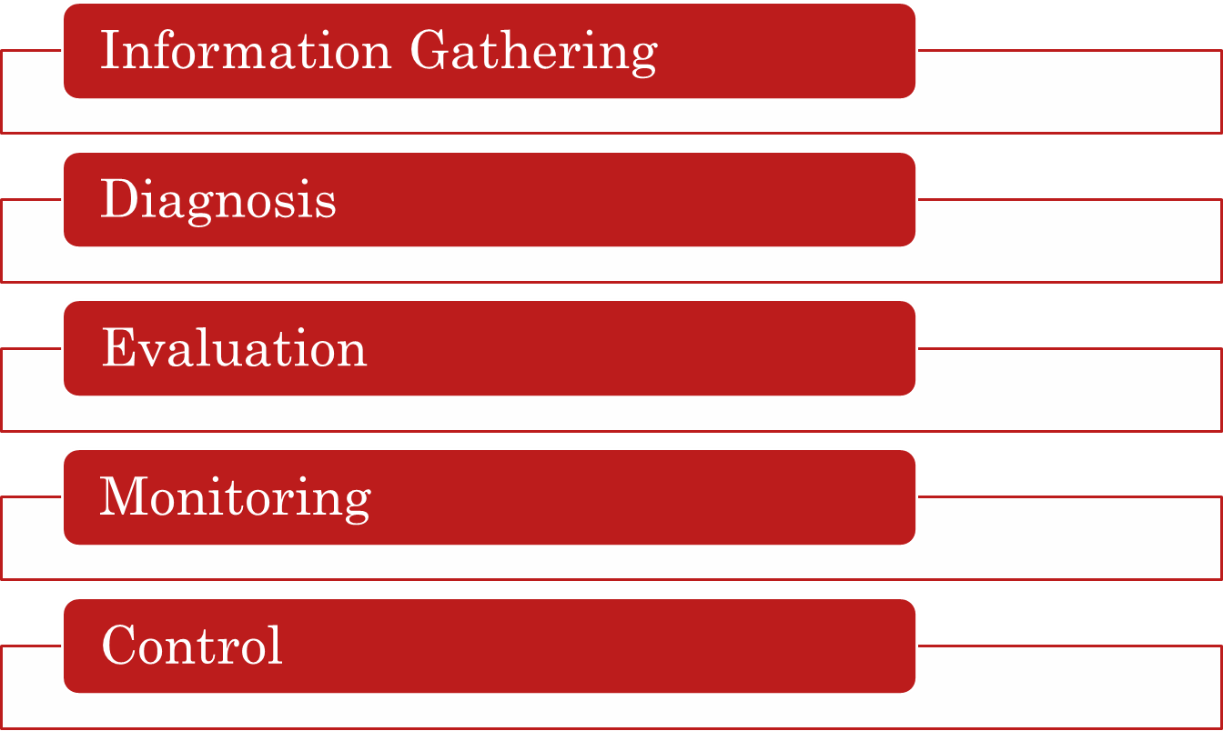
Basic Objective of Instrumentation System

Slide 29
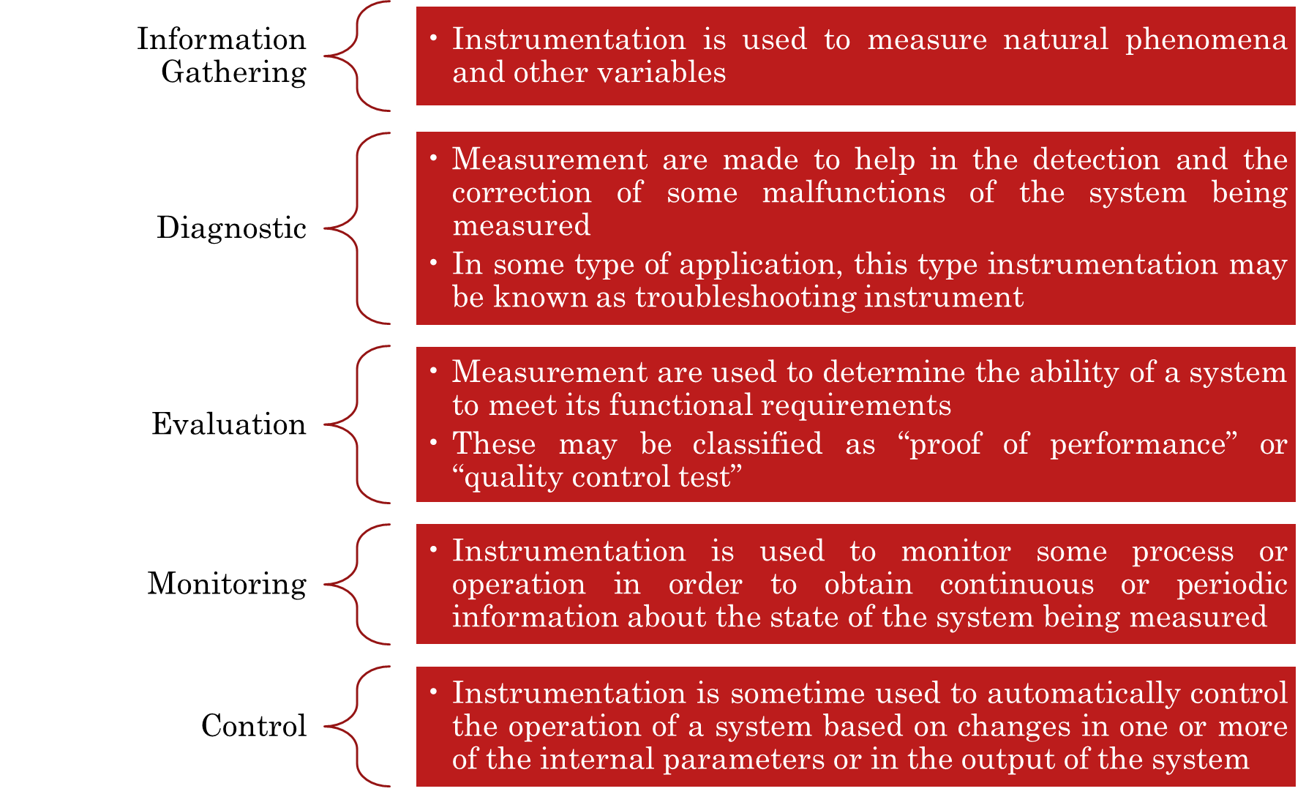

Slide 30
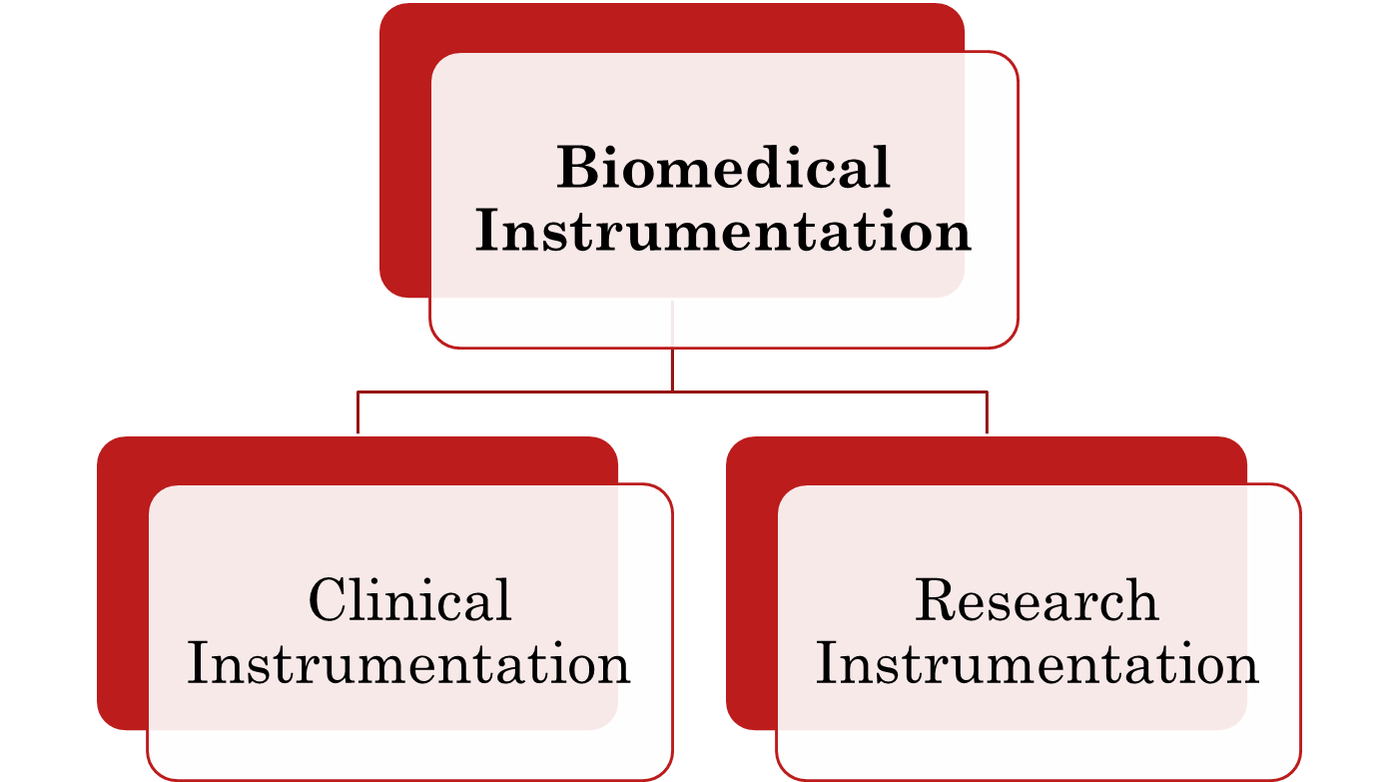
CLLASFICATION OF
BIOMEDICAL INSTRUMENTATION

Slide 31
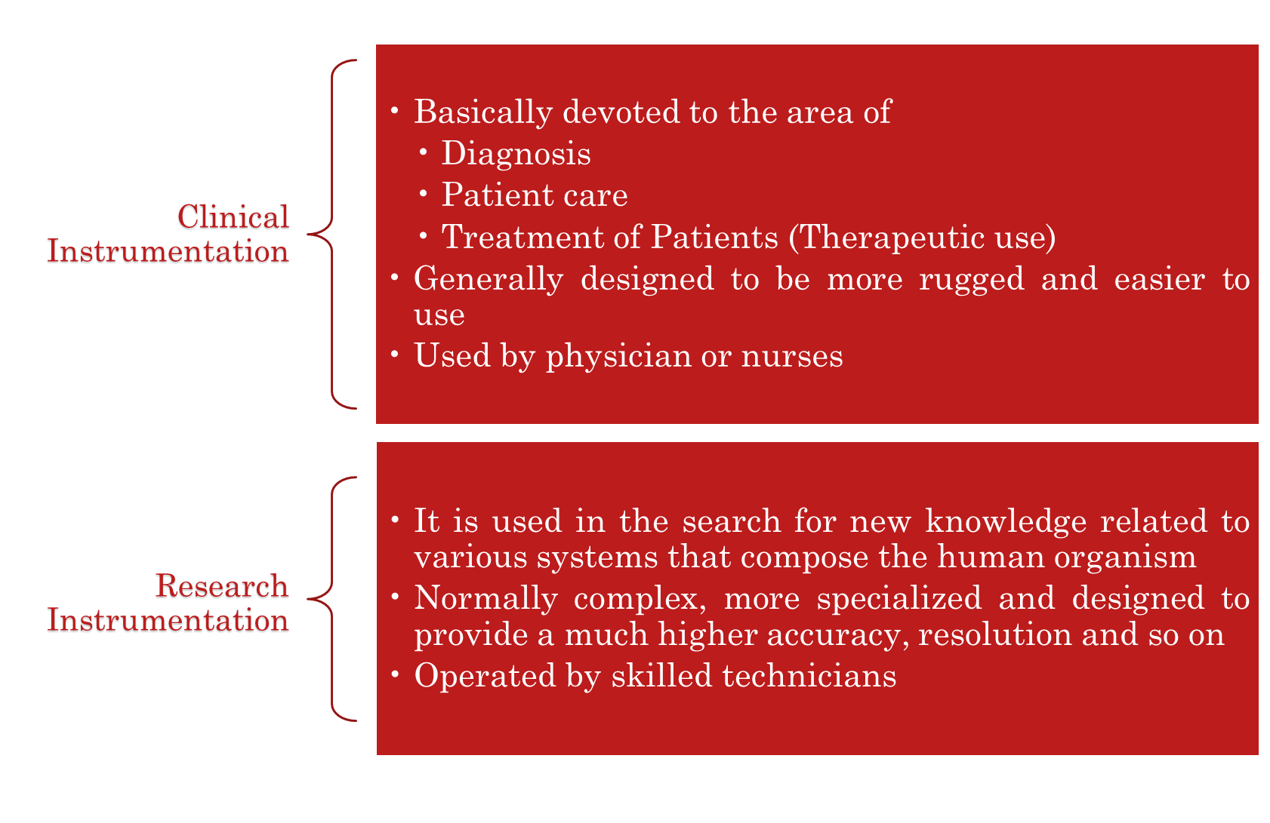
Some instruments can be used in both areas

Slide 32

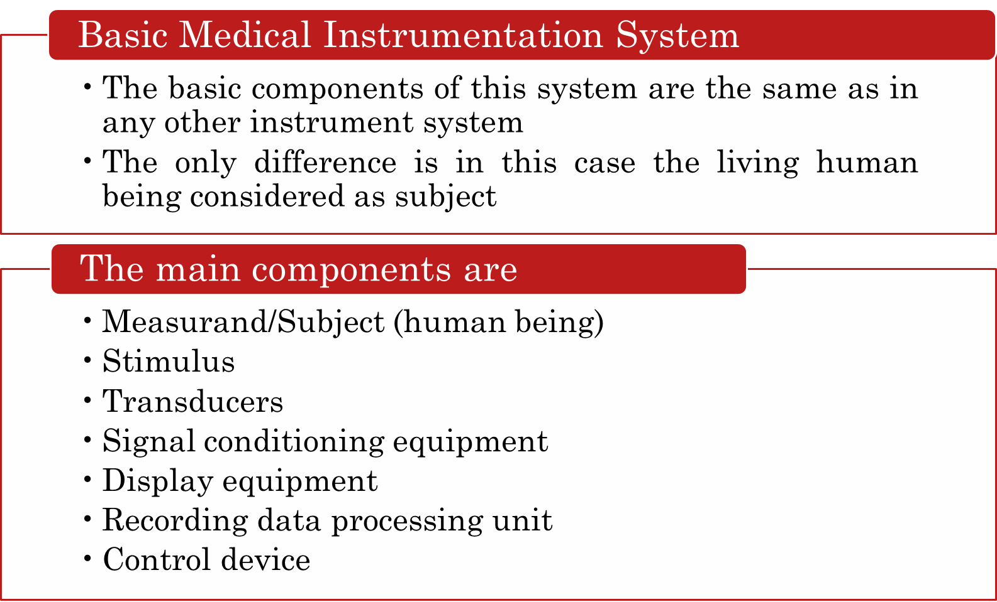

Slide 33
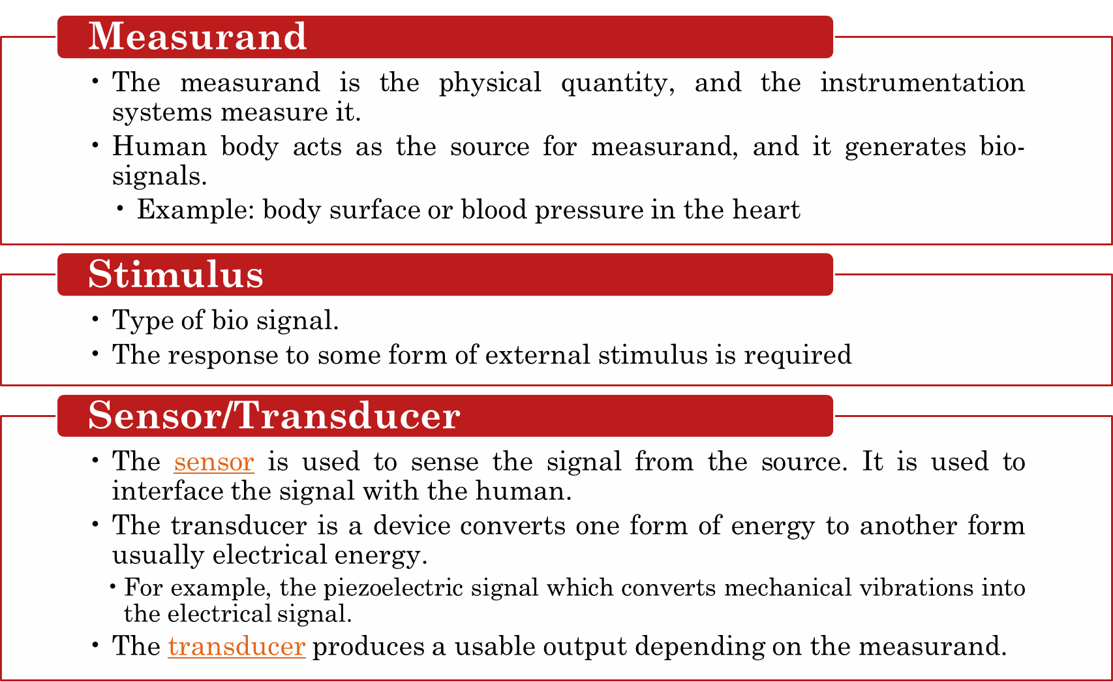
Any medical instrument consists of the following functional basic parts:

Slide 34
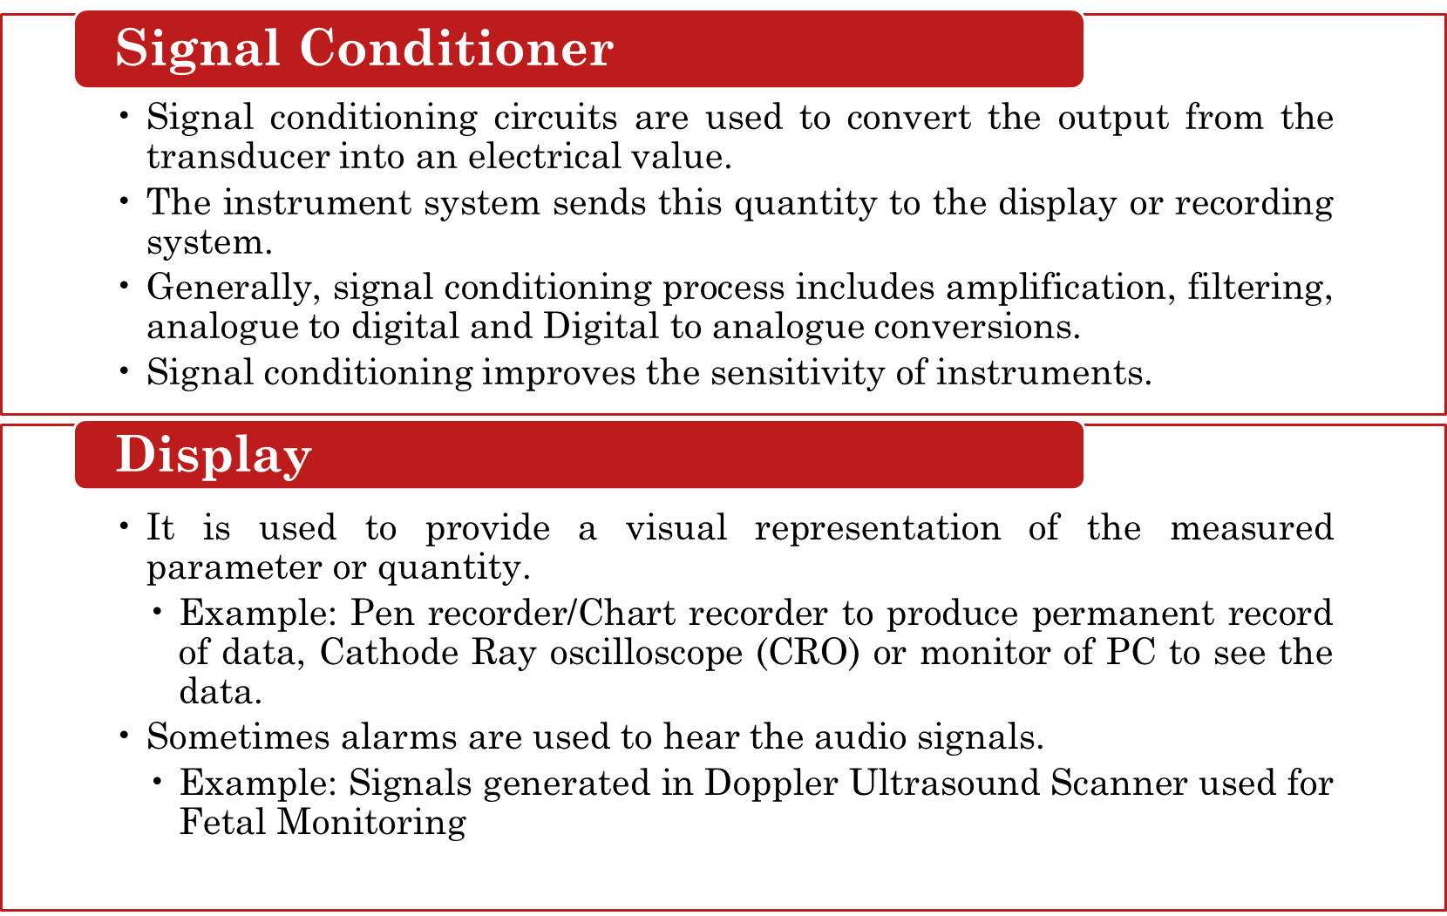

Slide 35
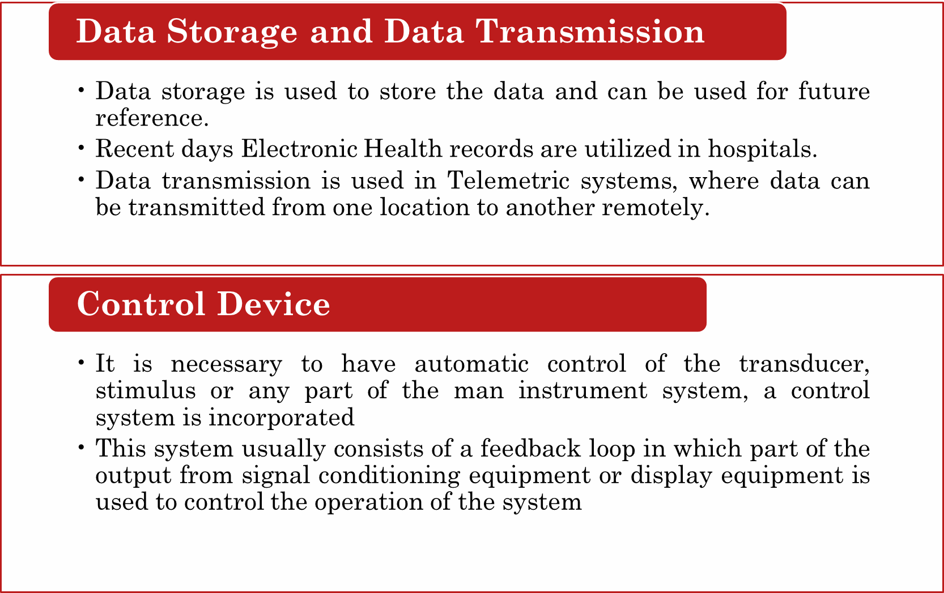

Slide 36
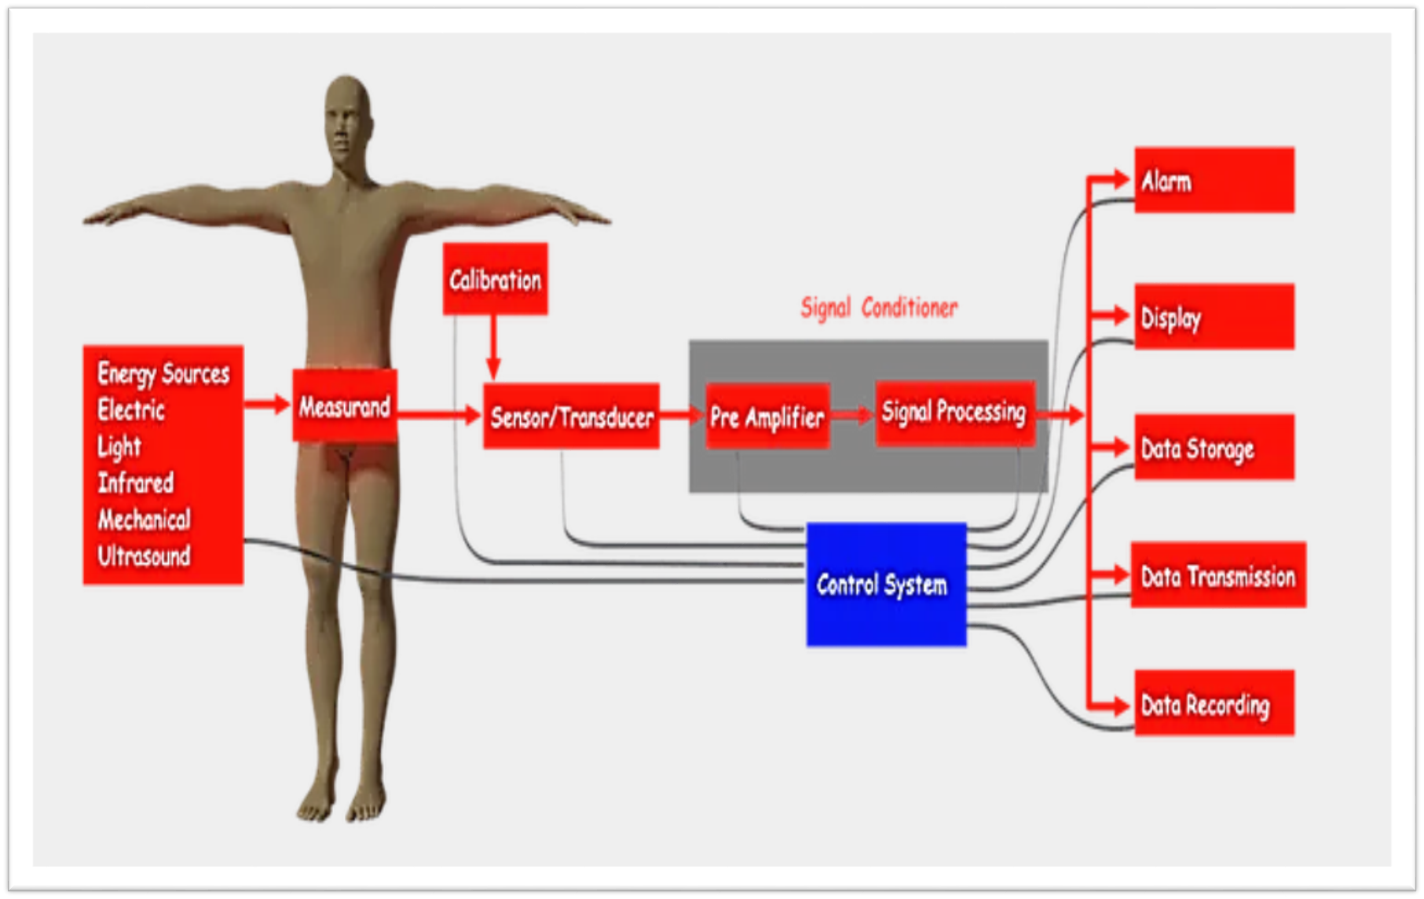

Slide 37
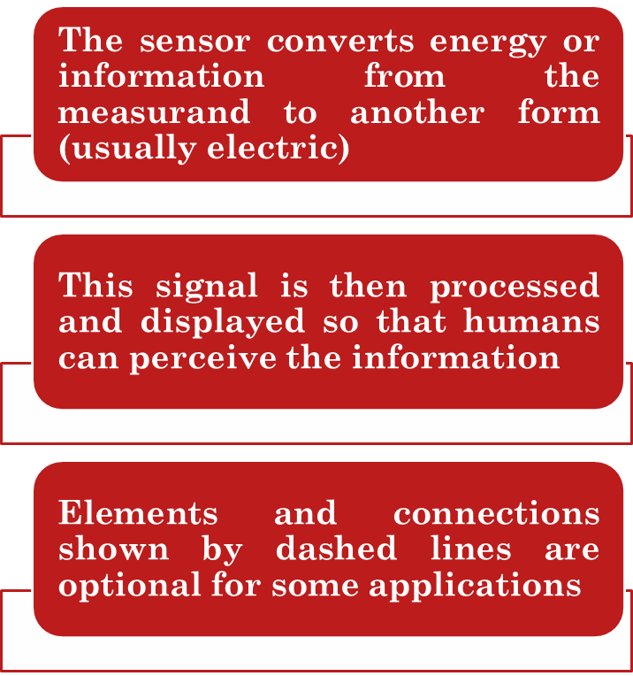
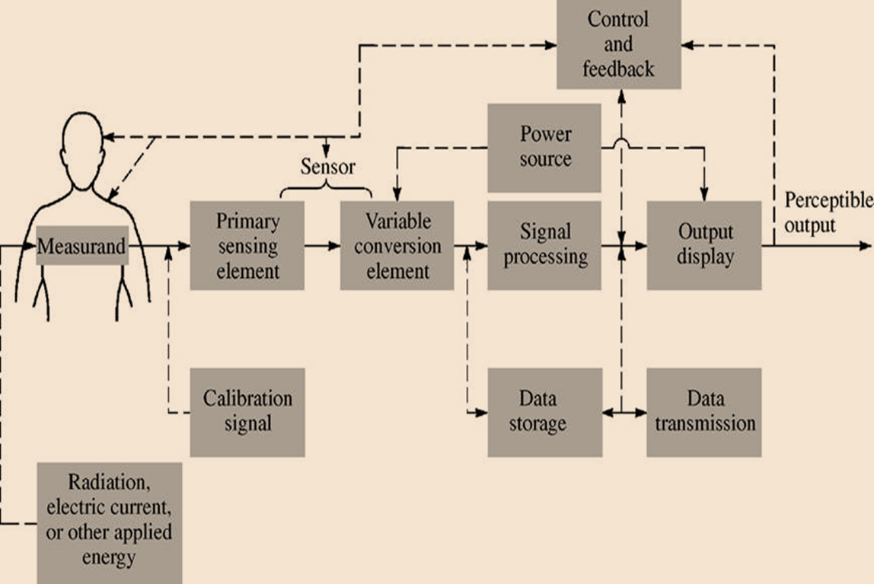
Generalized instrumentation system

Slide 38
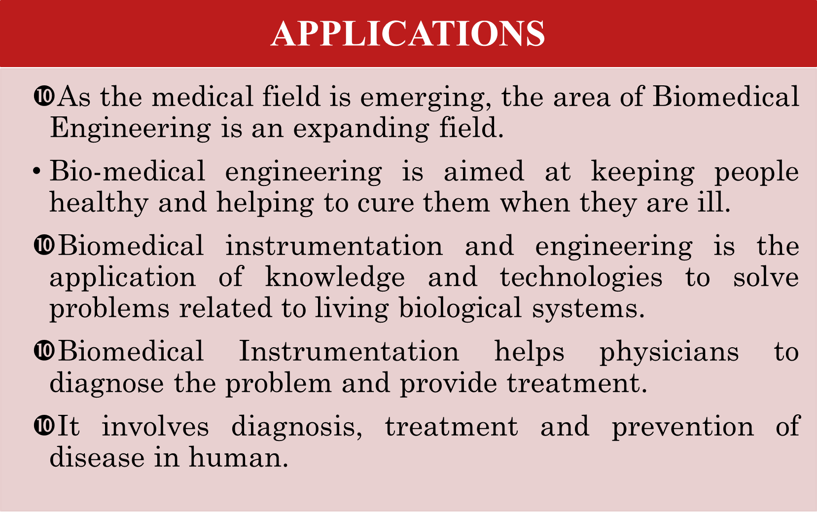

Slide 39
REFERENCES
C. R. Balamurugan and D. Periazhaagar Basics of Biomedical Instrumentation. Magnus Publications, Chennai ISBN: 978-81-939626-7-1
Gupta, P.K.. Cytology, Genetics and Molecular Biology, Rastogi Publishers, Meerut, 1993.
Roit I.M., Brostoff J. and Male D. Mosby .Immunology (6 th Edition) by, An imprint of Elsevier Sci Ltd., 2002.
G. Webster , Medical Instrumentation: Application And Design, 3rd edition ,Wiley Publishers
D Reddy, Biomedical Signal Processing, Tata Mcgraw Hill Publications.
Sergio Cerutti Advanced Methods of Biomedical Signal Processing, Oxford Publications.
B. Jacobson, J.G. Webster, Medical and Clinical Engineering, Prentice Hall, International.
Cromwell, Biomedical Instrumentation and Measurements, Prentice Hall, International.
R.S. Khandupur, Handbook of Biomedical Instrumentation, - Tata McGraw Hill
Leslie Cromwell, Fred J. Weibell, Erich A. Pfeiffer, "Biomedical Instrumentation and Measurements", Pearson Education.
https://nptel.ac.in/courses/121/106/121106008/
https://www.utoledo.edu/engineering/bioengineering/undergrad/prospective/whatisbioe.html#:~:text=Bioengineering%20is%20the%20application%20of,health%20care%20and%20other%20fields
https://i.pinimg.com/originals/68/c9/30/68c930e95113ceb2e3dfc9de2f164680.png
https://youtu.be/FBUpnG1G4yQ

Slide 40



